Slide 1

King County Housing Market Analysis
What decides a house value
By: Tamjid Ahsan
Date: Someday

Slide 2
Overview
King County is in the U.S. state of Washington.
12th largest county
Home Price:
$ 700K Median Listing,
$ 431 Median Listing Price/Sq Ft,
$ 766K Median Sold Price,
Around 6000 for sale and 2800 for rent.

Slide 3
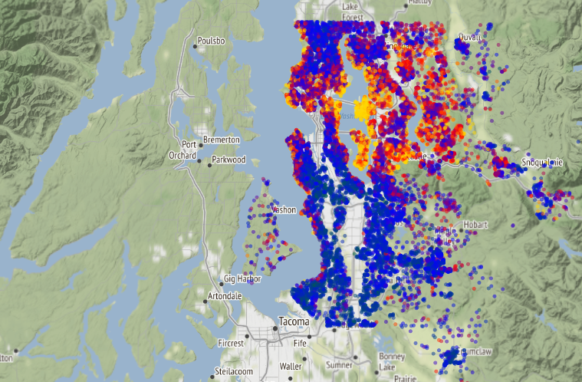
Business Problem
King County Residents that want to renovate their home to increase its resale value, but don't know what factors are important for determining a home's value. While focusing on features they can renovate, I shall discuss key factors of a home's price. This factors can be both under their constrain and beyond their control.
Those include:
How to improve marketability.
Focus on which aspect of the house.
What factors to keep in mind deciding budget and required return on investment.

Slide 4
Methodology
Dataset from Flatiron School GitHub repo.
After removing outliers sample size was 19975 with 20 predictors.
Using regression technique for prediction.
Accuracy of 62%

Slide 5
Recommendation On
Which areas you should focus.
Which ones you can be less worried about.
What to expect.

Slide 6
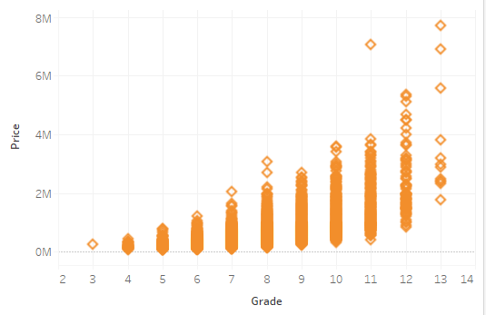
Grade
Hire better contractors thus making sure that the building materials and design is satisfactory.
Good finishing in interior and exterior.
High grade materials in both the exterior and interior

Slide 7
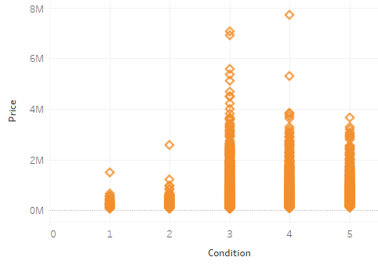
Condition
This is one of the most important factors.
Make sure that your house is at least average.
Coded 1-5. 1. Poor- Worn out. 2. Fair- Badly worn. 3. Average- Some evidence of deferred maintenance and normal obsolescence. 4. Good- No obvious maintenance required but neither is everything new. 5. Very Good- All items well maintained, many having been overhauled and repaired

Slide 8
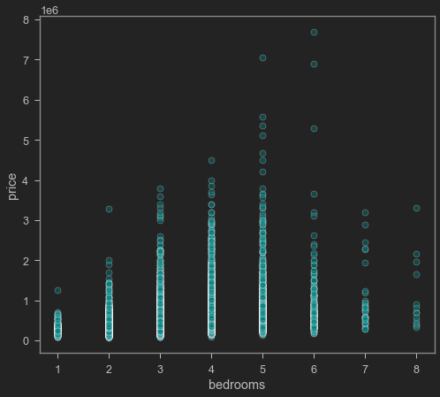
Bedrooms
Don’t make increasing this a priority
It has diminishing return after 5 bedrooms, instead increase living space

Slide 9
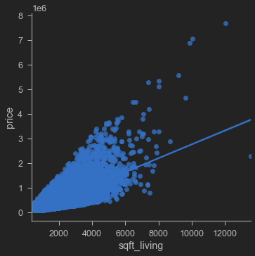
Sqft of living area
This is one of the most influential part of your home's value.
Make conscious effort to increase the living area by merging 2 rooms together or building 1 new one.

Slide 10
Last but not the least

Slide 11
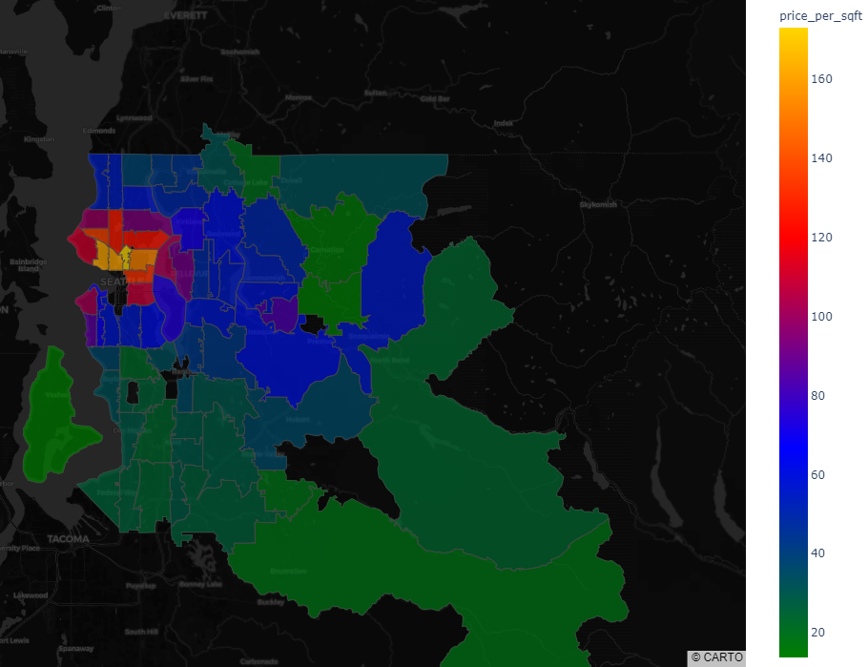
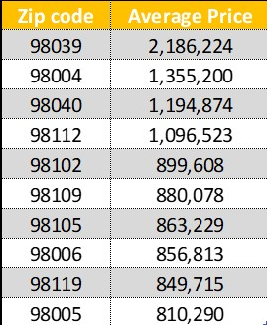
Location matters
Houses near the city has a higher value. If your house is in this zip codes, expect a higher value.

Slide 12
To recap
Homeowners should focus to:
Condition of the house is important. Invest on improving elements that improves that. Focus on higher quality building materials.
Try to increase sqft of living area; consider adding to the property.
Grade provided by the city is important. Read the guidelines and do things that improve grade. Like better materials
Don't be an outlier in the neighborhood in terms of living space. At least remodel to match that.
Bedrooms after 5 has a diminishing return. Do not focus on increasing. Instead invest on creating a better condition.
Basement sqft has a negative relation with value. Focus elsewhere.
Homeowners should be aware that:
Renovation has a positive impact on price.
Waterfront house has higher value.
Should expect more value if closer to the city

Slide 13

Next steps
Get some other info about the locations.
Monetary (e.g., Average property price), and
Cultural and
Recreational (e.g., Proximity to some stadium, local restaurant density, public transport, schools, parks)
Engineered more features. e.g .,
Total house sqft,
Bedroom to bathroom ratio.
And analyze those for better accuracy.

Slide 14
THANK YOU
GitHub: @tamjid-ahsan
LinkedIn: linkedin.com/in/tamjidahsan/
Project repo: https://github.com/tamjid-ahsan/dsc-phase-2-project

Slide 15

Appendix

Slide 16
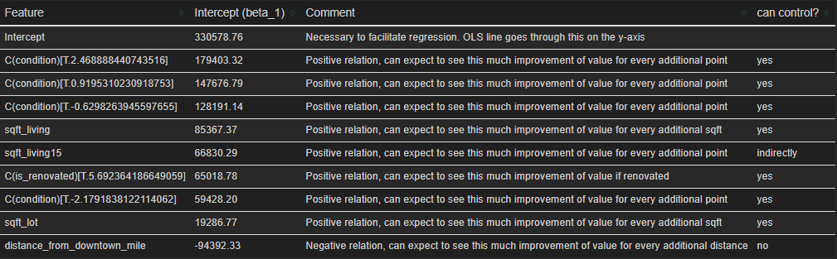
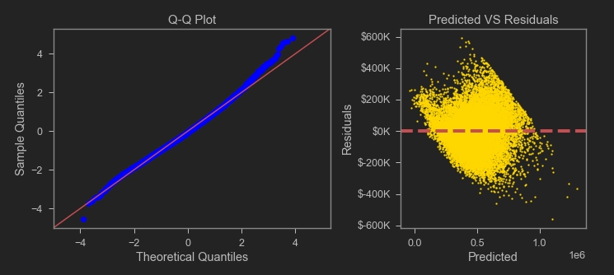
Regression Results
R squared is 62%.
No p value > 5%
Some bias

Slide 17
Grading system
Represents the construction quality of improvements. Grades run from grade 1 to 13. Generally defined as: 1-3 Falls short of minimum building standards. Normally cabin or inferior structure. 4 Generally older, low quality construction. Does not meet code. 5 Low construction costs and workmanship. Small, simple design. 6 Lowest grade currently meeting building code. Low quality materials and simple designs. 7 Average grade of construction and design. Commonly seen in plats and older sub-divisions. 8 Just above average in construction and design. Usually, better materials in both the exterior and interior finish work. 9 Better architectural design with extra interior and exterior design and quality. 10 Homes of this quality generally have high quality features. Finish work is better, and more design quality is seen in the floor plans. Generally, have a larger square footage. 11 Custom design and higher quality finish work with added amenities of solid woods, bathroom fixtures and more luxurious options. 12 Custom design and excellent builders. All materials are of the highest quality and all conveniences are present. 13 Generally custom designed and built. Mansion level. Large amount of highest quality cabinet work, wood trim, marble, entry ways etc.

Slide 18
Condition
Relative to age and grade. Coded 1-5. 1. Poor- Worn out. Repair and overhaul needed on painted surfaces, roofing, plumbing, heating and numerous functional inadequacies. Excessive deferred maintenance and abuse, limited value-in-use, approaching abandonment or major reconstruction; reuse or change in occupancy is imminent. Effective age is near the end of the scale regardless of the actual chronological age. 2. Fair- Badly worn. Much repair needed. Many items need refinishing or overhauling, deferred maintenance obvious, inadequate building utility and systems all shortening the life expectancy and increasing the effective age. 3. Average- Some evidence of deferred maintenance and normal obsolescence with age in that a few minor repairs are needed, along with some refinishing. All major components still functional and contributing toward an extended life expectancy. Effective age and utility is standard for like properties of its class and usage. 4. Good- No obvious maintenance required but neither is everything new. Appearance and utility are above the standard and the overall effective age will be lower than the typical property. 5. Very Good- All items well maintained, many having been overhauled and repaired as they have shown signs of wear, increasing the life expectancy and lowering the effective age with little deterioration or obsolescence evident with a high degree of utility.

